Slide 1
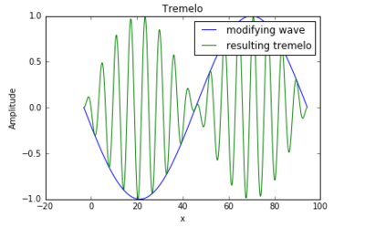
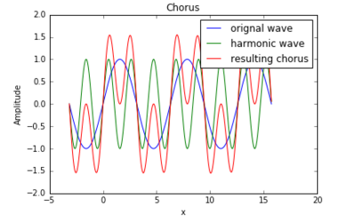
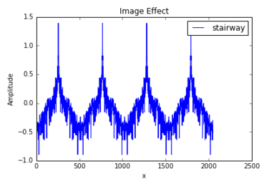
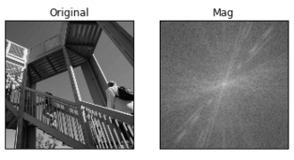
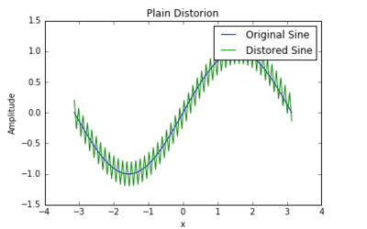
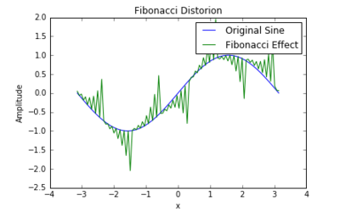

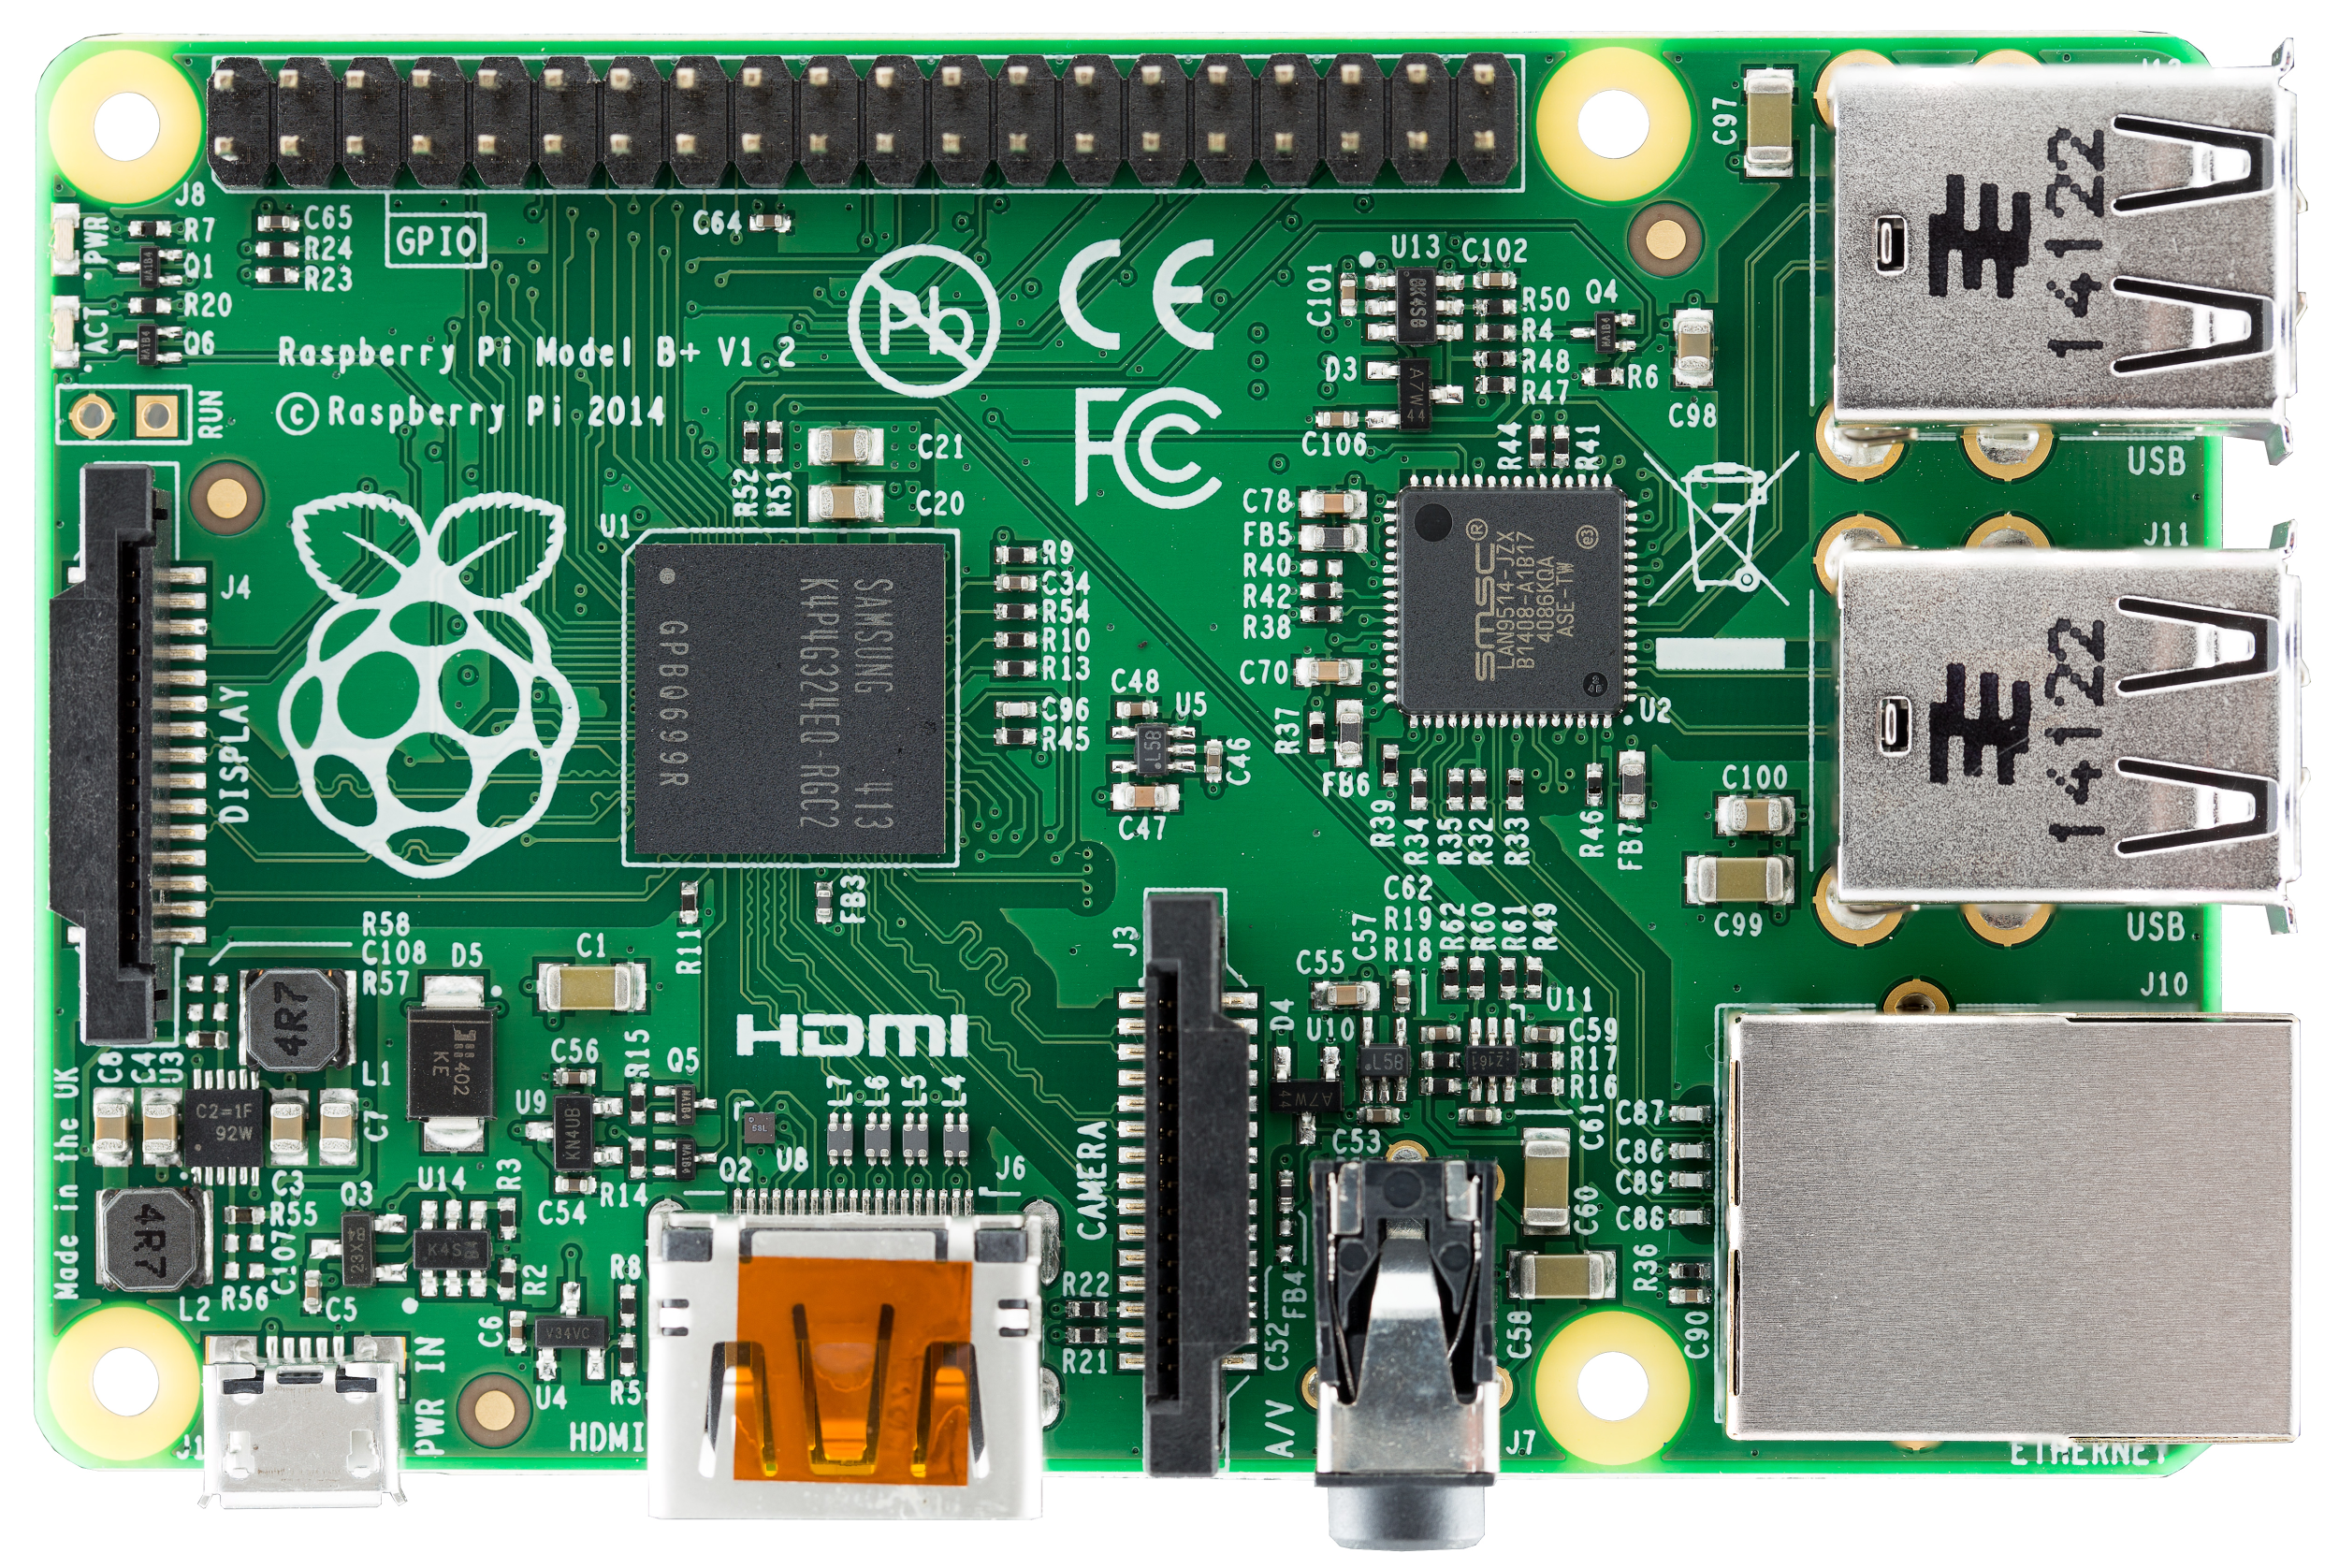

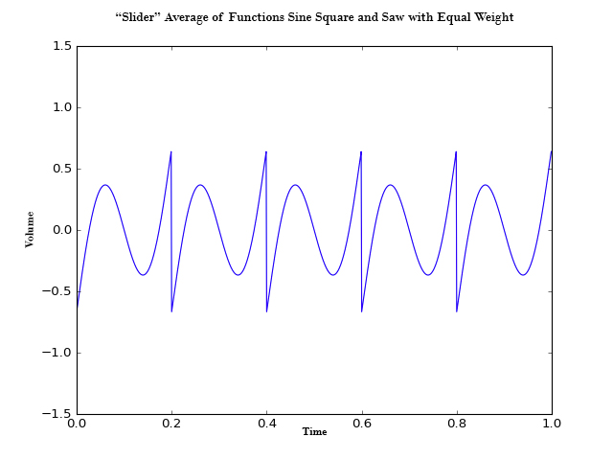
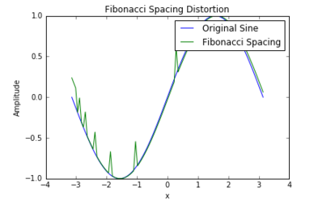
Digital Signal Processing and Real Time Application
Trevor “The Sky Wizard” Van Engelhoven, Charles “The Wizard” E. Fortune, Skyler “Sky” J. Hugo
Background
Results Continued
Signal processing has been a part of sound and sound production since the beginning of recorded and produced music. Typically sound was manipulated using analog devices, however with the emergence of computers digital processing became popular due to the potential and simplicity. This project aims to use Python through “PureData” to emulate effects typically seen in the music industry. Additional new and creative effects were designed and implemented to demonstrate the power of digital signal processing. The design and application process is discussed.
Tremolo: an effect that is seen in primarily rock music but is used in many genres. It is created by altering the amplitude of the wave according to a user given pattern. This is most recognizable is raising and lowering a sound’s volume in a patterned way.
Chorus/Phasor: an effect that is attributed to classical music, but is used in all genres. The effect is created by adding a waveform with additional harmonic waveforms of corresponding frequency with value n*frequency) where n is an integer.
Methods
Function definitions were used to create sinusoidal, square, and saw wave patterns.
Numerous effects were researched and implemented using numpy array manipulations which alter the generated waves.
Each effect manipulation was converted into pure noise format in order to be used with a raspberry pi microcontroller.
Code was optimized for real time sound manipulation running through a controller.
Picture effect: an effect that turns an image into a wave effect. A two dimensional fourier transform of an image is sliced in the middle and plotted. Physically the transform
Results
Distortion: an effect that is attributed to rock and metal music. It is achieved by making random amplitude manipulations in a wave to effectively ‘blur’ the signal. Numerous extra distortion effects were made with the fibonacci sequence.
has a larger central value for large smooth features in the original image and large surrounding values for smaller sharp features in the original image which defines the wave uniquely.
Application: Putting it All Together
Pure Data
Output
To get real time signal modulation we first output each effect as a numpy array. This format can’t be used for processing so py/pyext converts python to “pure noise” format. The Raspberry pi continuously takes
Slider: an effect seen in electronic music but is occasionally used in other genres. It effectively changes the waveform between a triangle, square, and sinusoidal wave in real time.
Converter
Input
Pure Python
input signal and modifies it according the the pure noise file before returning a signal output.
Acknowledgements
Downey, Allen B. Think Dsp Digital Signal Processing in Python. Oreilly & Associates, 2016. Print.
Downey, Allen B. Think Python. Sebastopol, CA: O'Reilly, 2012. Print.
Puckette, Miller. "Pd Community Site." Pure Data. Web. 2016.
https://github.com/ASU-CompMethodsPhysics-PHY494/final-digital-signal-processor.git

